Slide 1
2023 Asan HeLP Challenge Topic 4 Vessel Sclerosis Segmentation in T1-weighted MRI Images with Two-Stage nnU-Net
역사는 밤에 쓰여진다
Wonjoong Cheon¹, Kang Houn Lee², Young Kyu Lee¹, Young Nam Kang^{*1}
1. Department of Radiation Oncology, Seoul St. Mary’s Hospital, College of Medicine, The Catholic University of Korea, Seoul, Korea
2. Department of Biomedicine & Health Sciences, The Catholic University of Korea, Seoul, Korea

Slide 2
Contents
Preprocessing
Model
Train
Post-processing and First, second, and third Submission result
Notes:
목차는 다음과 같습니다.

Slide 3
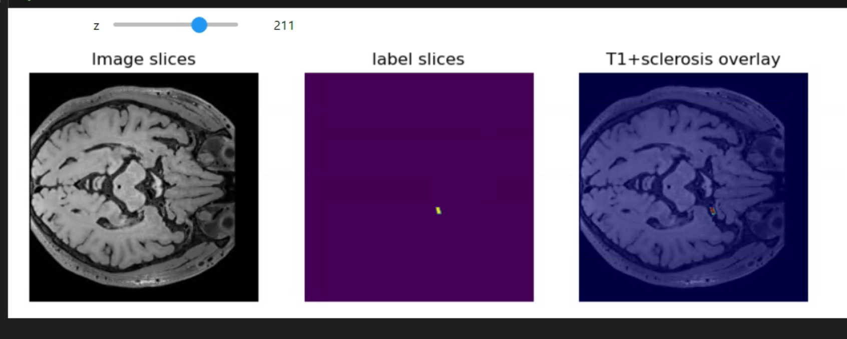
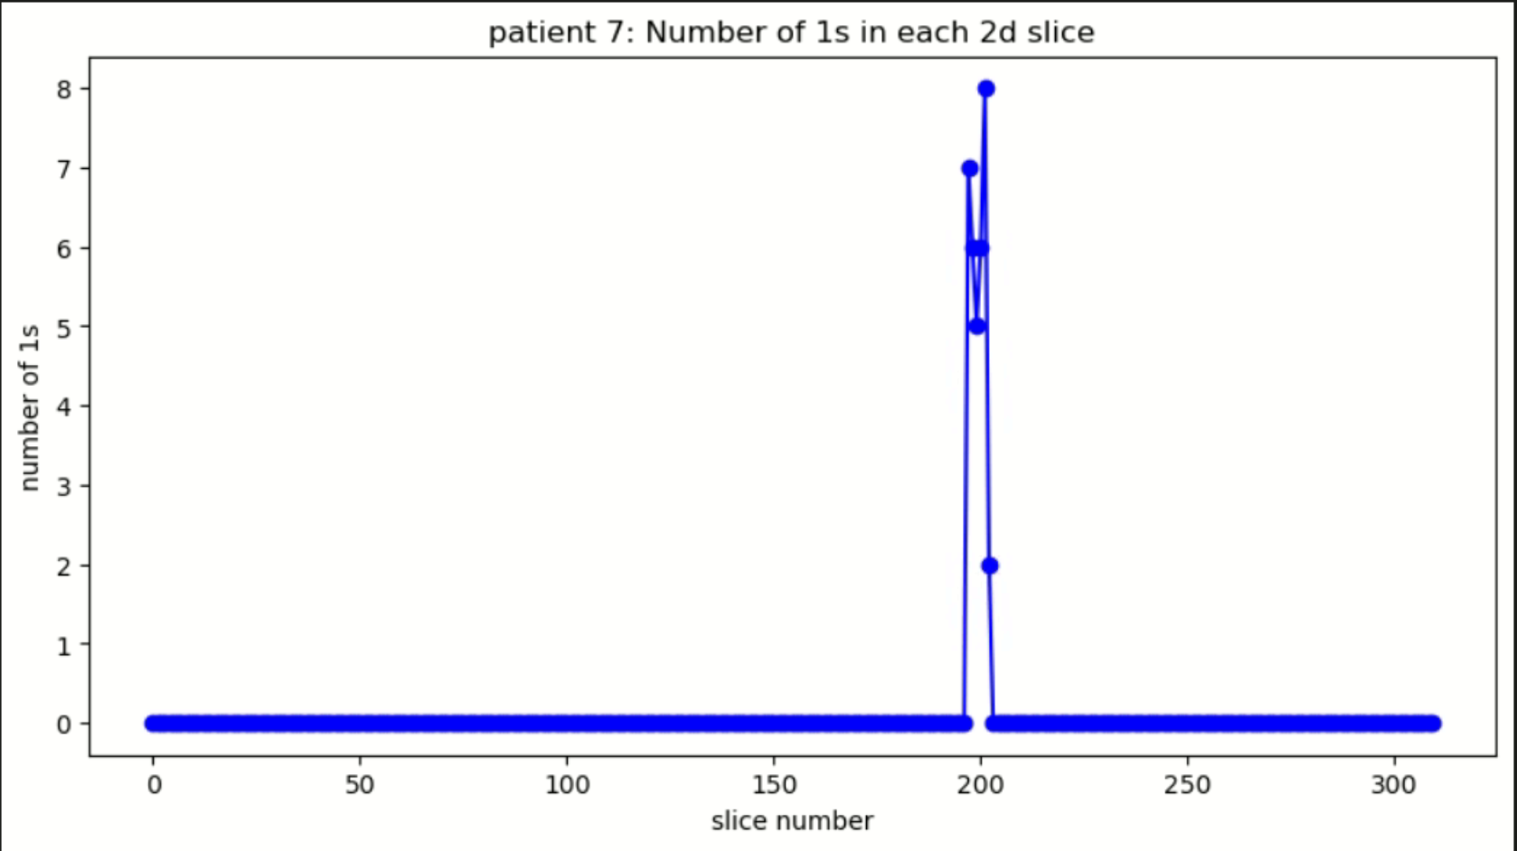
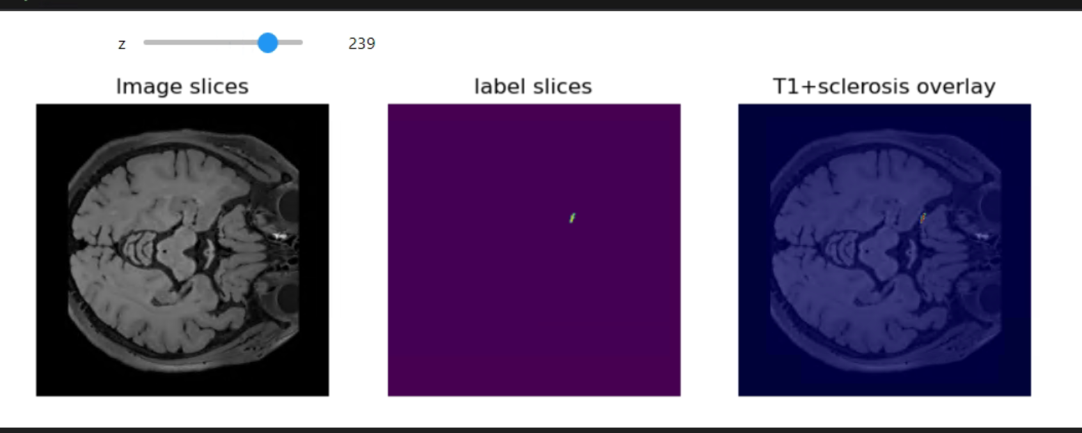
Preprocessing – Dataset EDA
Provided Dataset
80 T1-MRI images (50 : train, 30 : test)
Vessel / Pathology / Hemisphere written CSV
Width * Height: 320 * 320 Slice number: 300 ~ 320 images
Nifti Images
T1-weighted Image and Lesion Mask
Fig. 1. slice location of vessel sclerosis
Fig. 2. Example of MR images and corresponding ground truth images

Slide 4
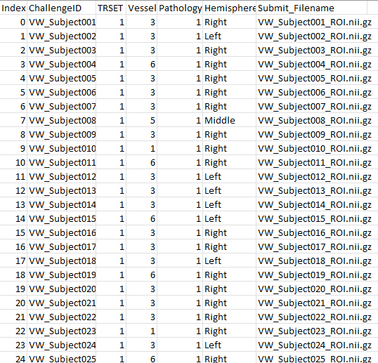
Preprocessing – Dataset EDA
Provided Dataset
80 T1-MRI images (50 : train, 30 : test)
Vessel / Pathology / Hemisphere written CSV
Vessel category
Vessel 1 = Internal Carotid Artery
Vessel 3 = Middle Cerebral artery
Vessel 5 = Basilar Artery
Vessel 6 = Vertebral Artery
Pathology category
Pathology 1 = Atherosclerosis
Pathology 4 = Vasculitis
Hemisphere category
Left
Middle
Right
Fig. 3. Provided information of vessel sclerosis
Notes:
목차는 다음과 같습니다.

Slide 5
Preprocessing – Dataset EDA
Identify features by dividing CSV values
Vessel 1(Internal Carotid Artery), Hemisphere Left
Vessel 1, Hemisphere Right
Vessel 3(Middle Cerebral artery), Hemisphere Left
Vessel 3, Hemisphere middle
Vessel 3, Hemisphere Right
Vessel 5(Basilar Artery), Hemisphere middle
Vessel 6(Vertebral Artery), Hemisphere Left
Vessel 6, Hemisphere Right
Crop appropriate area to segment accurate ROI in several 2d distribution and long Z slices

Slide 6
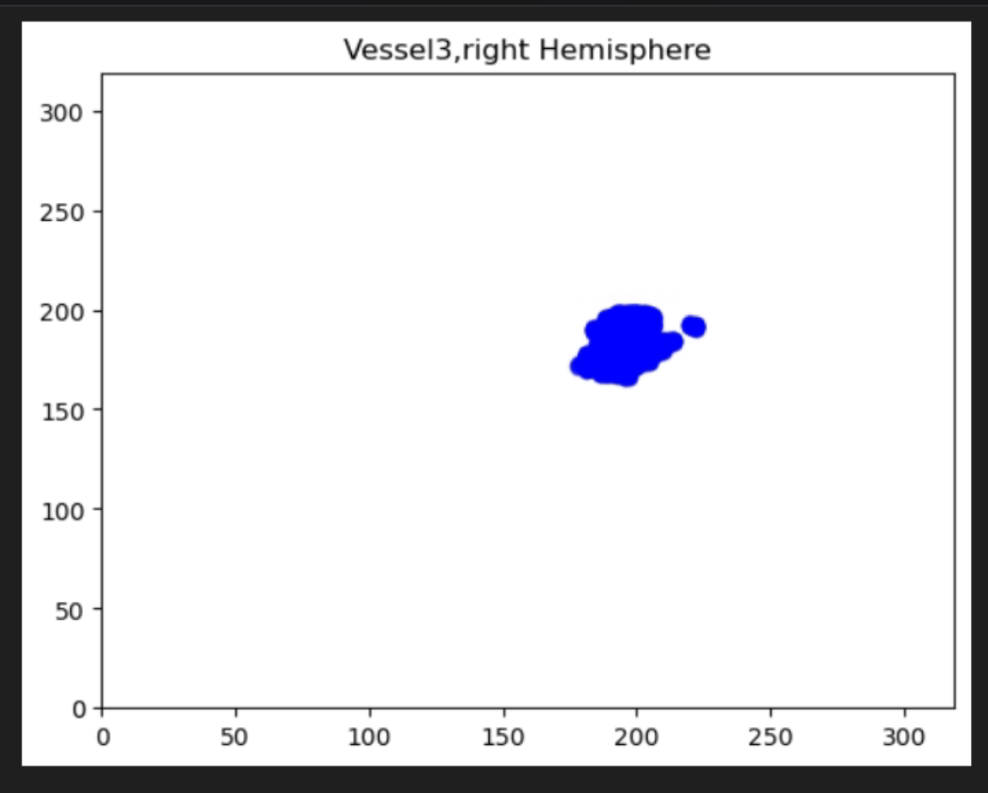
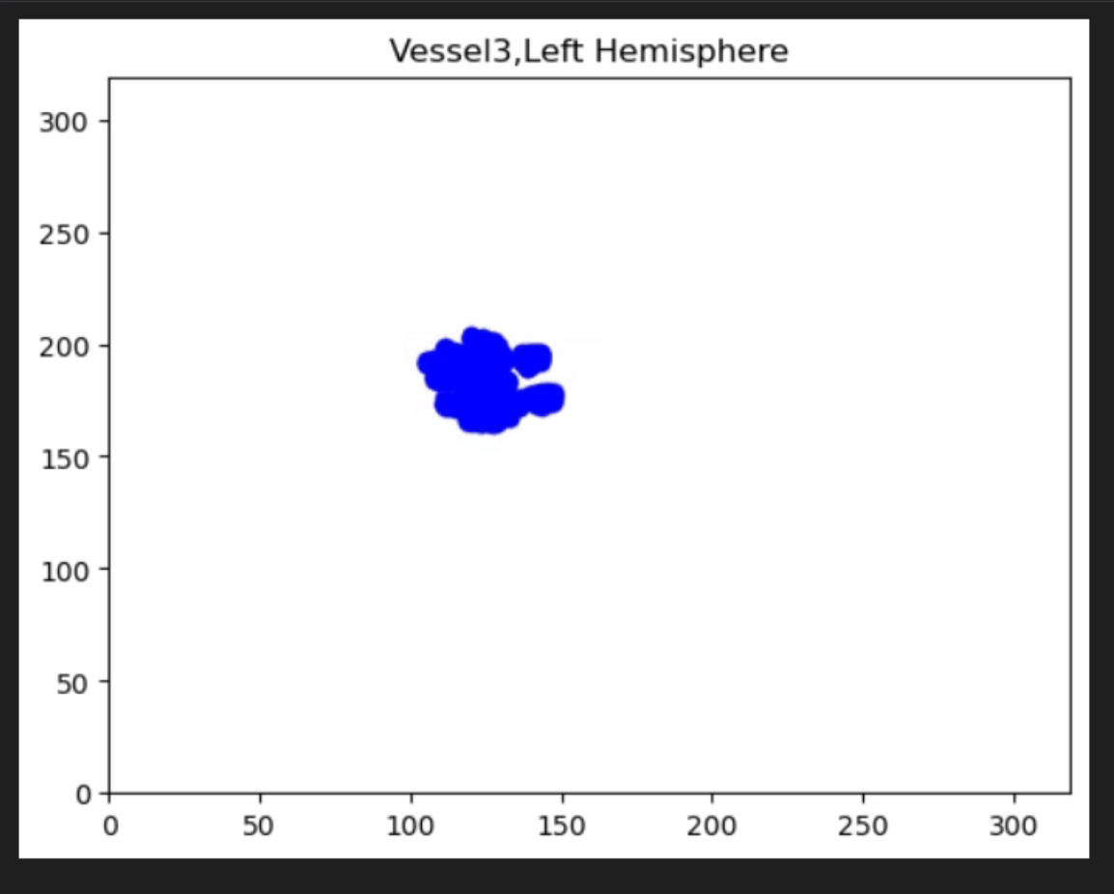
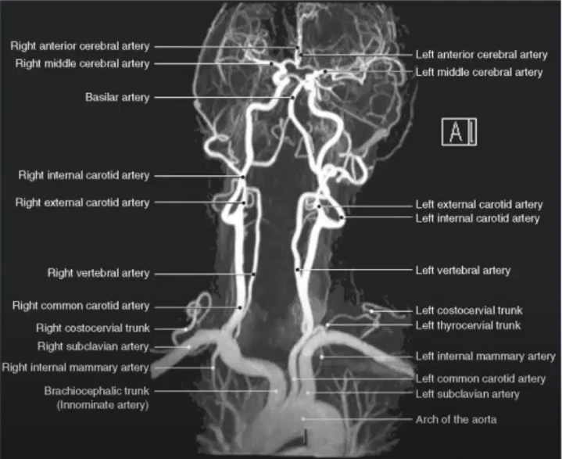
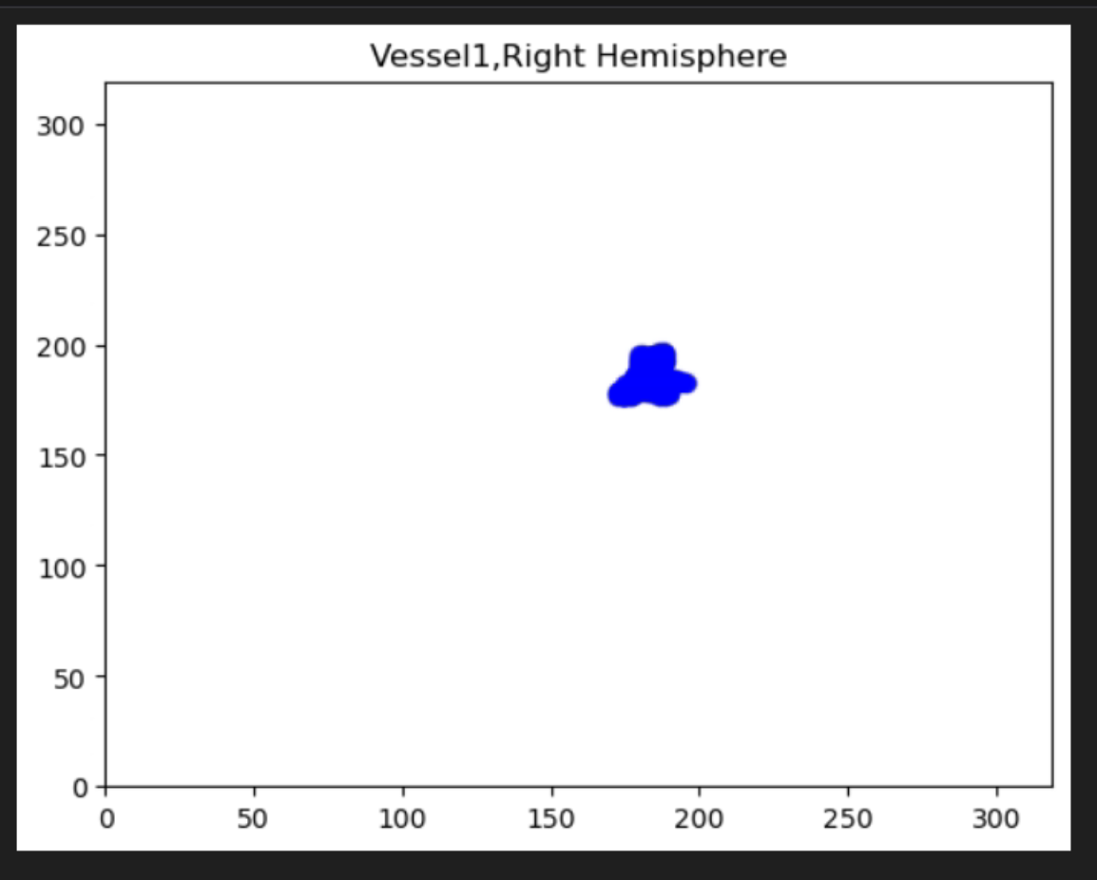
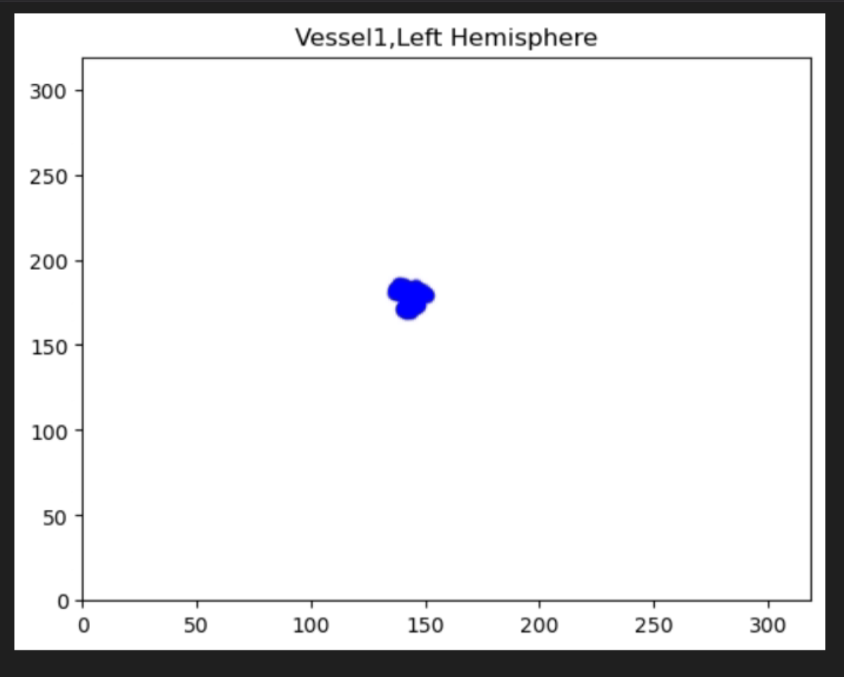
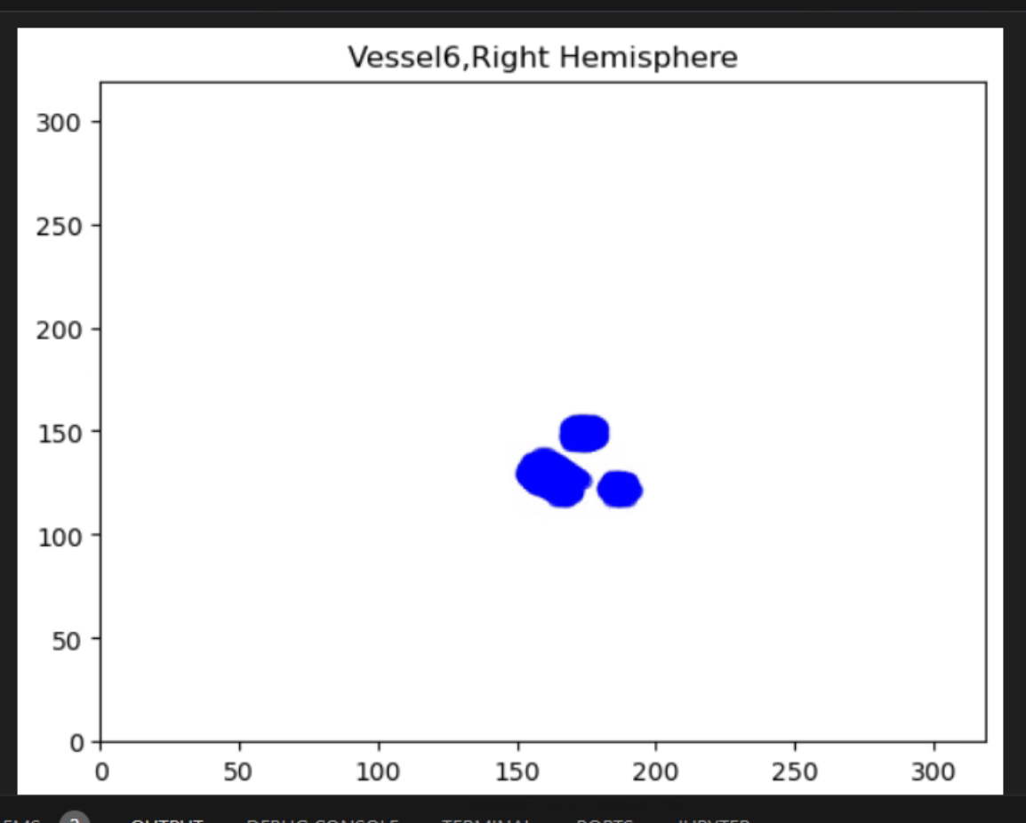
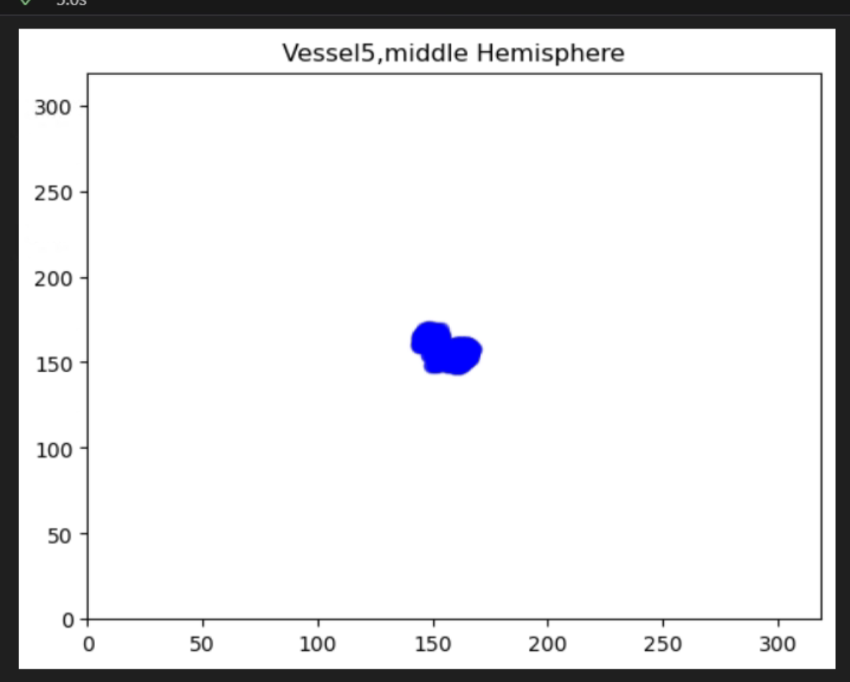
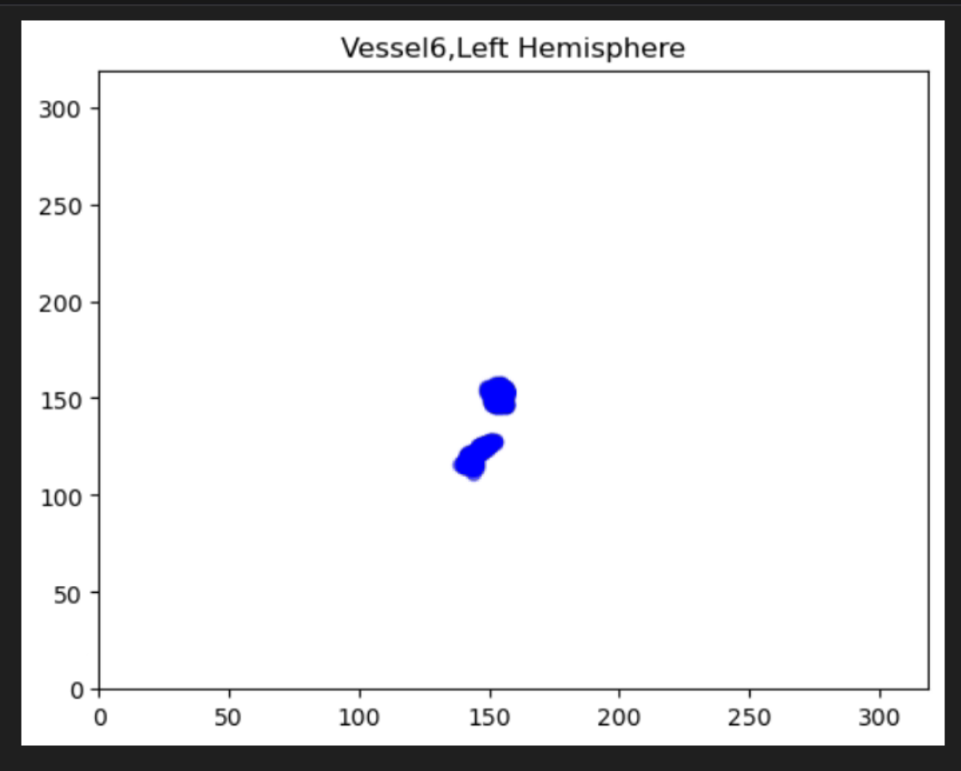
Preprocessing – Dataset EDA: Spatial information analysis
MCA / Right / 182 ~ 233
MCA / Left / 111 ~ 242
Brain vessel / Hemisphere / slice number
ICA / Right / 173 ~ 220
ICA / Left / 102 ~ 213
VA / Right / 118 ~ 169
BA / Middle / 150 ~ 187
VA / Left / 133 ~ 152

Slide 7
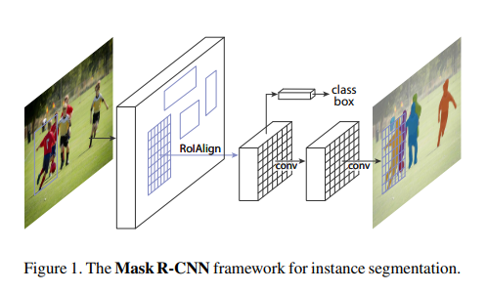
Preprocessing – Dataset EDA
MCA / Right / 182 ~ 233
MCA / Left / 111 ~ 242
He, Kaiming, et al. "Mask r-cnn." Proceedings of the IEEE international conference on computer vision. 2017.
Brain vessel / Hemisphere / slice number
ICA / Right / 173 ~ 220
ICA / Left / 102 ~ 213
VA / Right / 118 ~ 169
BA / Middle / 150 ~ 187
VA / Left / 133 ~ 152

Slide 8
Preprocessing – Dataset EDA: Spatial information analysis
MCA / Right / 182 ~ 233
MCA / Left / 111 ~ 242
Brain vessel / Hemisphere / slice number
ICA / Right / 173 ~ 220
ICA / Left / 102 ~ 213
VA / Right / 118 ~ 169
BA / Middle / 150 ~ 187
VA / Left / 133 ~ 152

Slide 9
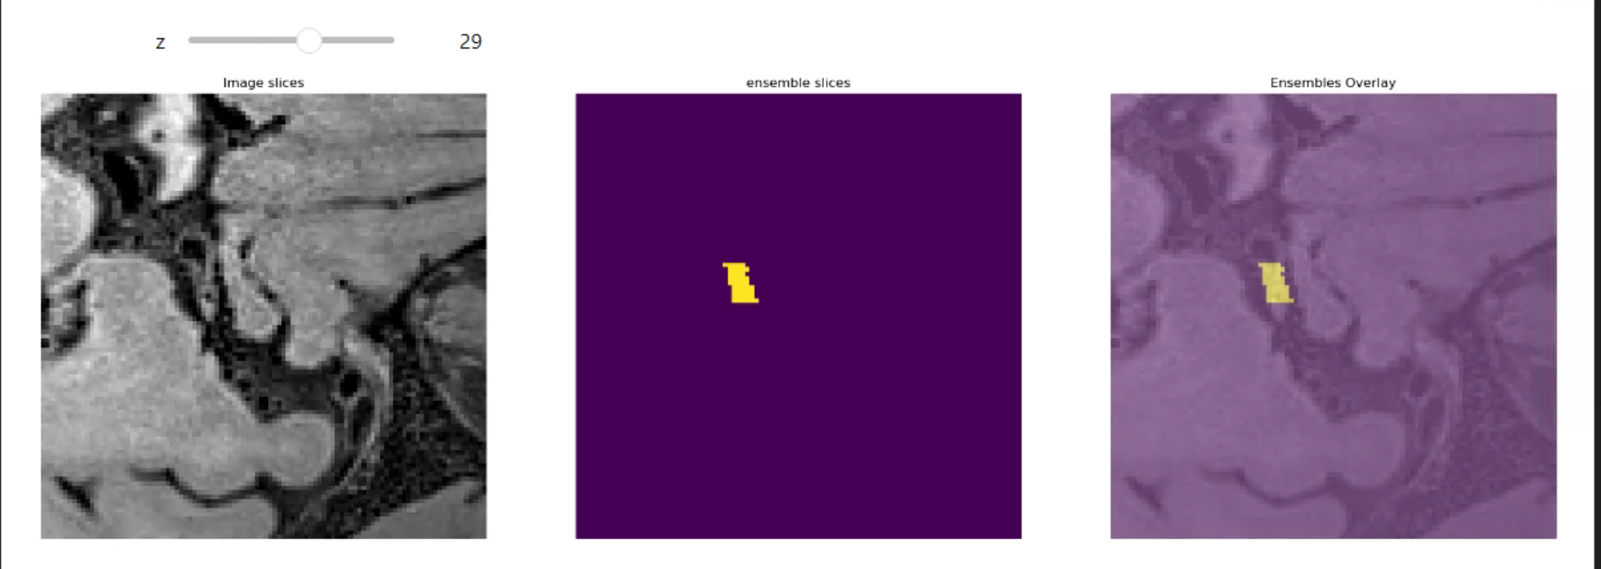
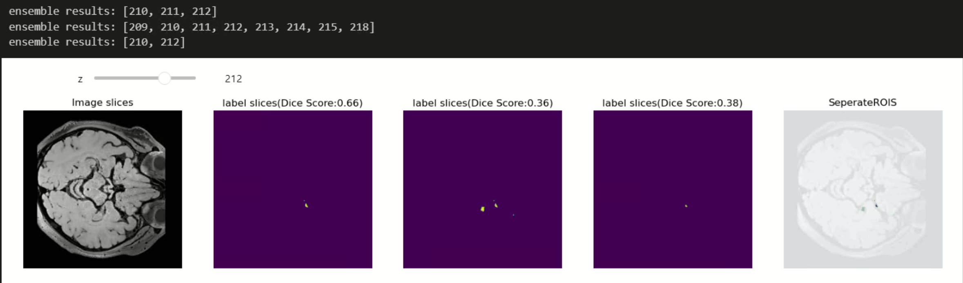
Preprocessing – Crop Dataset (Width * Height = 100 * 100)
Crop Area
Vessel 1, left = 173 to 222 crop / x,y coord [150:250,150:250]
Vessel 1, right = 102 to 213 crop / x,y coord [100:200,150:250]
Vessel 3, left = 111 to 242 crop / x,y coord [100:200, 150:250]
Vessel 3, right = 182 to 233 crop / x,y coord [150:250,150:250]
Vessel 5, middle = 150 to 187 crop / x,y coord [100:200,100:200]
Vessel 6, left =133 to 152 crop / x,y coord [100: 200, 100:200]
Vessel 6, right = 118 to 169 crop / x,y coord [100:200,100:200]
Non label Area
Crop the part does not contain the label to a size (100,100,x)
Distribution of datasets with and without labels is 1:1
Deep learning model
Original Image
Crop Image
Segmented Label
Original ROI

Slide 10
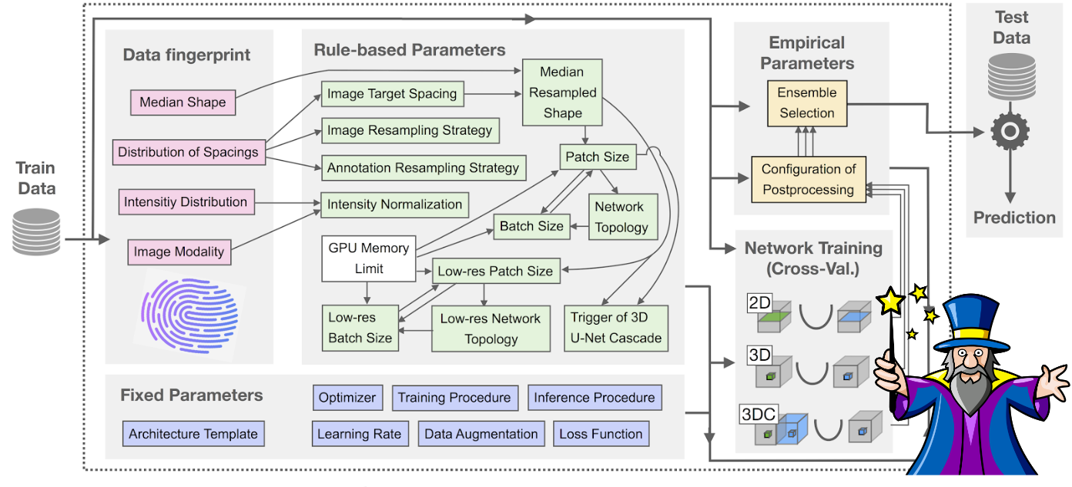
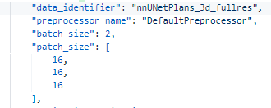
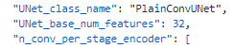
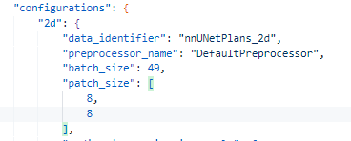
Model
Isensee, F., Jaeger, P. F., Kohl, S. A., Petersen, J., & Maier-Hein, K. H. (2021). nnU-Net: a self-configuring method for deep learning-based biomedical image segmentation. Nature methods, 18(2), 203-211.
Model
nnU-Net (no new U-net)
nnU-Net_Plan.json
Model plan parameter file
Can Change patch_size, model(plain U-Net, Resnet)
PlainConvUnet
Patch_size
2d : [8, 8]
3d : [16,16,16]
Augmentation
nnU-Net augmentation prompt
nnU-Net Augmentation DA = 4
Crop Randomly in Original Dataset in no label area
Train
Epoch 1000
Learning rate Decay
Dice + CrossEntropyLoss
→ Manually editing the nnUNet parameters: Rule-based parameters
nnUNet specification
nnUNet parameter

Slide 11
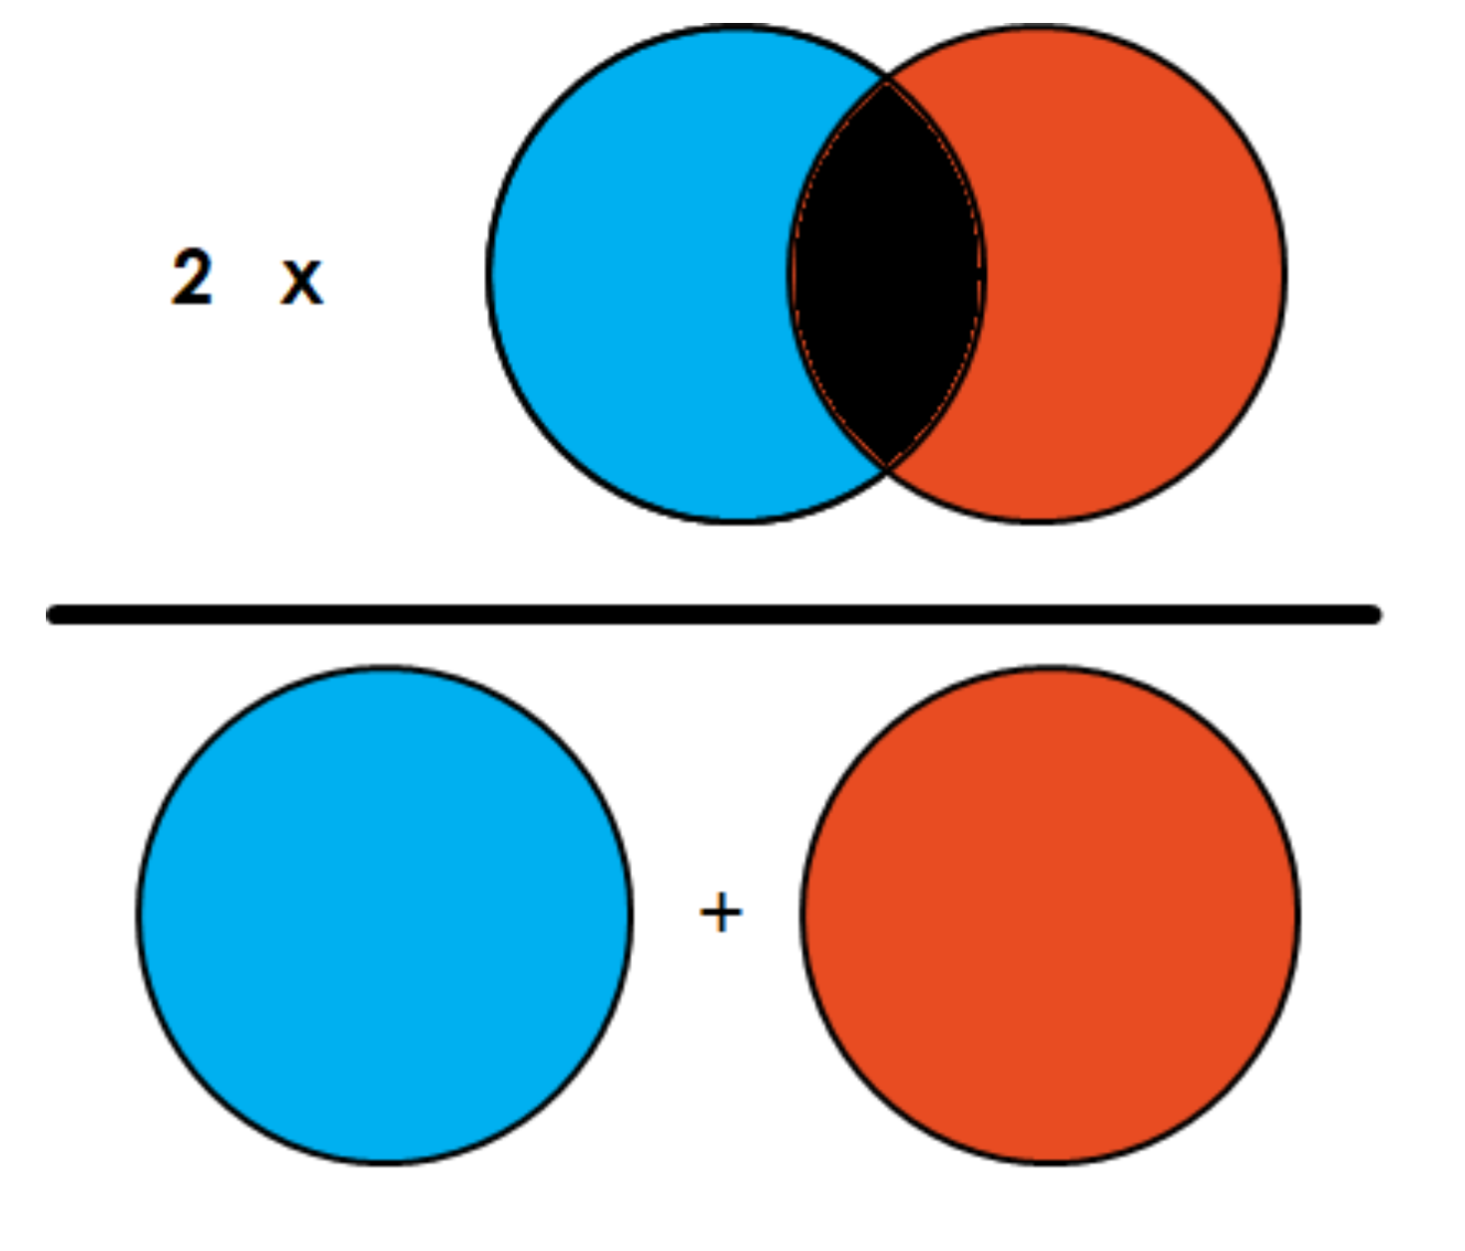
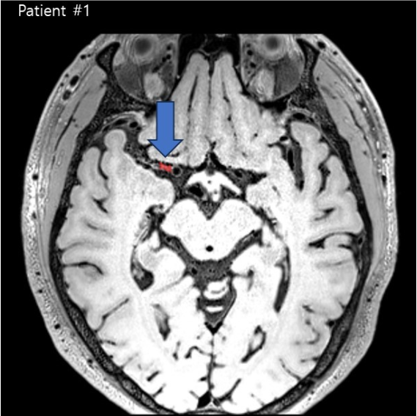
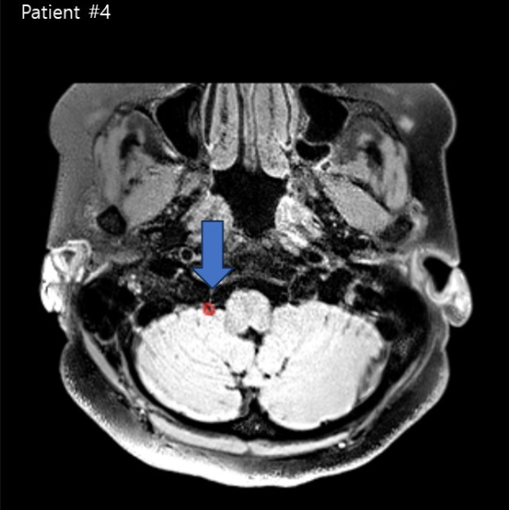
Train
Evaluate method
DSC (Dice Coefficient Score)
Dice=2∗∣A∩B∣/(∣A∣+∣B∣)​=(TP+FP)+(TP+FN)2∗TP​﻿
Sclerosis sizes are various, it is difficult for the model to segment the total area in general
Model development focused on specifying where sclerosis will be and expanding its scope.
Few dataset has too small ROI to segment its ROI, so using scipy Dilate and Erode to find appropriate ROI.
Fig. 5. Schematic image for Dice similarity score
Fig. 4. Example of vessel sclerosis on MRI

Slide 12
1st Submit / Postprocessing
Submit model : nnU-Net 2d model + 3d_fullres model ensemble / 2d model / 3d model
210, 212 slice in
2d model seg results
Z slice 210, 212
Label in Z slices
210 ~ 213
211 slice in
Ensemble model seg results
Trim each csv values
label distribution
3d model seg results
Z slice 209 ~215, 218

Slide 13
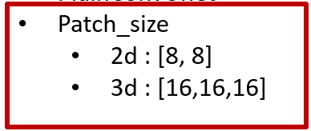
1st Submit
0.35
Submit model : nnU-Net 2d model + 3d_fullres model ensemble / 2d model / 3d model
patient | Ensemble | 2d | 3d | patient | Ensemble | 2d | 3d | patient | Ensemble | 2d | 3d
51 | 0.1858 | 0 | 0.1742 | 61 | 0 | 0 | 0 | 71 | 0.6596 | 0.1807 | 0.4653
52 | 0.4454 | 0.0434 | 0.3620 | 62 | 0.5260 | 0.3636 | 0.3734 | 72 | 0.3036 | 0.0253 | 0.1294
53 | 0.3779 | 0.4421 | 0.0556 | 63 | 0 | 0 | 0 | 73 | 0.6479 | 0.2676 | 0.4361
54 | 0.4045 | 0.3809 | 0.3225 | 64 | 0 | 0 | 0 | 74 | 0.5644 | 0 | 0.4591
55 | 0.7635 | 0.5531 | 0.6624 | 65 | 0.1147 | 0.0865 | 0.1526 | 75 | 0.5797 | 0.1428 | 0.2072
56 | 0 | 0.2926 | 0.3310 | 66 | 0.3225 | 0 | 0.3225 | 76 | 0 | 0 | 0
57 | 0 | 0 | 0 | 67 | 0.0432 | 0 | 0.0421 | 77 | 0.2429 | 0.2457 | 0.176
58 | 0.6589 | 0.3818 | 0.3586 | 68 | 0 | 0 | 0.0085 | 78 | 0.1090 | 0.2530 | 0.1007
59 | 0.1 | 0 | 0.1 | 69 | 0.5838 | 0.2494 | 0.4403 | 79 | 0.5354 | 0.1176 | 0.1760
60 | 0.5312 | 0.3762 | 0.4956 | 70 | 0.3535 | 0.2551 | 0.2869 | 80 | 0.0845 | 0.5142 | 0.0179
* Dice similarity score

Slide 14
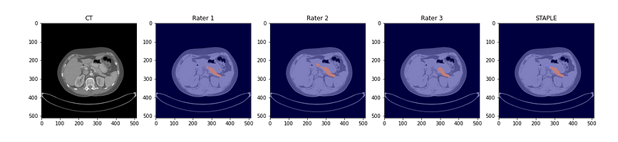
2nd Submit / Postprocessing
Submit model : Ensemble method / Ensemble + STAPLE + Dilate / Ensemble + STAPLE + Erode
Fig. 6. Example of three radiologists’ segmentation of the pancreas in abdominal CT. Blue is labeled “1” (“pancreas”). Background (transparent) is labeled “0”. Image by author.
Make 10 deep learning pretrained model and voting label: 2D+3D ensemble with different seed number
STAPLE (Simultaneous Truth and Performance Level Estimation):
STAPLE relies on majority voting; it can underestimate the edges of the structure.
Erode/Dilate operations are employed to enhance the probability of achieving the maximum score by diversifying the distribution of regions of interest (ROI).
S. K. Warfield, K. H. Zou and W. M. Wells, "Simultaneous truth and performance level estimation (STAPLE): an algorithm for the validation of image segmentation," in IEEE Transactions on Medical Imaging, vol. 23, no. 7, pp. 903-921, July 2004, doi: 10.1109/TMI.2004.828354.

Slide 15
2nd Submit
0.37
Submit model : Ensemble method (10 models: 2D, 3D) Ensemble + STAPLE + Dilate Ensemble + STAPLE + Erode
patient | Ensemble | dilate | erode | patient | Ensemble | dilate | erode | patient | Ensemble | dilate | erode
51 | 0.1962 | 0.1397 | 0.0519 | 61 | 0 | 0 | 0 | 71 | 0.6988 | 0.6244 | 0.2134
52 | 0.4081 | 0.4265 | 0.0150 | 62 | 0.5549 | 0.5512 | 0.1069 | 72 | 0.3044 | 0.4341 | 0.0255
53 | 0.4421 | 0.3977 | 0.0408 | 63 | 0 | 0 | 0 | 73 | 0.6516 | 0.4522 | 0.3489
54 | 0.5120 | 0.3480 | 0.1666 | 64 | 0 | 0 | 0 | 74 | 0.6377 | 0.3722 | 0.3865
55 | 0.7910 | 0.6383 | 0.4611 | 65 | 0.2583 | 0.3018 | 0.0755 | 75 | 0.3108 | 0.1704 | 0.4482
56 | 0.56 | 0.3844 | 0.1282 | 66 | 0.45 | 0.4366 | 0.0810 | 76 | 0.0606 | 0.1522 | 0
57 | 0.1442 | 0.1205 | 0.0307 | 67 | 0 | 0 | 0 | 77 | 0.4479 | 0.5209 | 0.0582
58 | 0.6993 | 0.5352 | 0.1956 | 68 | 0.0795 | 0.2222 | 0 | 78 | 0.4052 | 0.4864 | 0
59 | 0 | 0 | 0 | 69 | 0.6210 | 0.5337 | 0.2067 | 79 | 0.5714 | 0.3357 | 0.12
60 | 0.6551 | 0.4728 | 0.2888 | 70 | 0.3620 | 0.3037 | 0.2249 | 80 | 0.5625 | 0.4225 | 0
* Dice similarity score

Slide 16
2nd Submit
0.37
Submit model : Ensemble method (10 models: 2D, 3D) Ensemble + STAPLE + Dilate Ensemble + STAPLE + Erode
patient | Ensemble | dilate | erode | patient | Ensemble | dilate | erode | patient | Ensemble | dilate | erode
51 | 0.1962 | 0.1397 | 0.0519 | 61 | 0 | 0 | 0 | 71 | 0.6988 | 0.6244 | 0.2134
52 | 0.4081 | 0.4265 | 0.0150 | 62 | 0.5549 | 0.5512 | 0.1069 | 72 | 0.3044 | 0.4341 | 0.0255
53 | 0.4421 | 0.3977 | 0.0408 | 63 | 0 | 0 | 0 | 73 | 0.6516 | 0.4522 | 0.3489
54 | 0.5120 | 0.3480 | 0.1666 | 64 | 0 | 0 | 0 | 74 | 0.6377 | 0.3722 | 0.3865
55 | 0.7910 | 0.6383 | 0.4611 | 65 | 0.2583 | 0.3018 | 0.0755 | 75 | 0.3108 | 0.1704 | 0.4482
56 | 0.56 | 0.3844 | 0.1282 | 66 | 0.45 | 0.4366 | 0.0810 | 76 | 0.0606 | 0.1522 | 0
57 | 0.1442 | 0.1205 | 0.0307 | 67 | 0 | 0 | 0 | 77 | 0.4479 | 0.5209 | 0.0582
58 | 0.6993 | 0.5352 | 0.1956 | 68 | 0.0795 | 0.2222 | 0 | 78 | 0.4052 | 0.4864 | 0
59 | 0 | 0 | 0 | 69 | 0.6210 | 0.5337 | 0.2067 | 79 | 0.5714 | 0.3357 | 0.12
60 | 0.6551 | 0.4728 | 0.2888 | 70 | 0.3620 | 0.3037 | 0.2249 | 80 | 0.5625 | 0.4225 | 0
* Dice similarity score

Slide 17
2nd Submit
Score change : 0.35 > 0.37
patient | 1st submit | 2nd submit | patient | 1st submit | 2nd submit | patient | 1st submit | 2nd submit
51 | 0.1858 | 0.1962 | 61 | 0 | 0 | 71 | 0.6596 | 0.6988
52 | 0.4081 | 0.4265 | 62 | 0.5260 | 0.5549 | 72 | 0.3036 | 0.4341
53 | 0.4421 | 0.4421 | 63 | 0 | 0 | 73 | 0.6479 | 0.6516
54 | 0.5120 | 0.5120 | 64 | 0 | 0 | 74 | 0.5644 | 0.6377
55 | 0.7910 | 0.7910 | 65 | 0.1526 | 0.3018 | 75 | 0.5797 | 0.4482
56 | 0.56 | 0.56 | 66 | 0.3225 | 0.45 | 76 | 0 | 0.1522
57 | 0.1442 | 0.1442 | 67 | 0.0432 | 0 | 77 | 0.2457 | 0.5209
58 | 0.6993 | 0.6993 | 68 | 0.0085 | 0.2222 | 78 | 0.2530 | 0.4864
59 | 0 | 0 | 69 | 0.5838 | 0.6210 | 79 | 0.5354 | 0.5714
60 | 0.6551 | 0.6551 | 70 | 0.3535 | 0.3620 | 80 | 0.5142 | 0.5625
* Dice similarity score

Slide 18
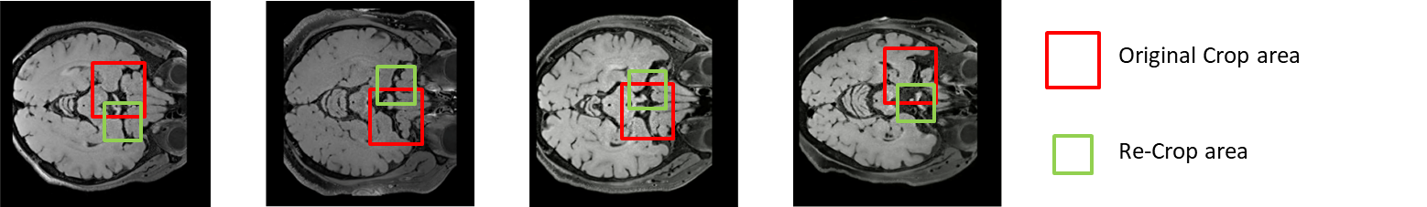
3rd Submit / Preprocessing
- Submit model : 59,61,63,64 patient re-crop area.
* Dice score

Slide 19
3rd Submit
0.44
Score change : 0.37 > 0.44
patient | 2nd submit | 3rd submit | patient | 2nd submit | 3rd submit | patient | 2nd submit | 3rd submit
51 | 0.1962 | 0.1962 | 61 | 0 | 0.2101 | 71 | 0.6988 | 0.6988
52 | 0.4265 | 0.4265 | 62 | 0.5549 | 0.5549 | 72 | 0.4341 | 0.4341
53 | 0.4421 | 0.4421 | 63 | 0 | 0.2698 | 73 | 0.6516 | 0.6516
54 | 0.5120 | 0.5120 | 64 | 0 | 0.3439 | 74 | 0.6377 | 0.6377
55 | 0.7910 | 0.7910 | 65 | 0.3018 | 0.3018 | 75 | 0.4482 | 0.4482
56 | 0.56 | 0.56 | 66 | 0.45 | 0.4366 | 76 | 0.1522 | 0.1522
57 | 0.1442 | 0.1442 | 67 | 0 | 0.0774 | 77 | 0.5209 | 0.5209
58 | 0.6993 | 0.6993 | 68 | 0.2222 | 0.2222 | 78 | 0.4864 | 0.4864
59 | 0 | 0.2857 | 69 | 0.6210 | 0.6210 | 79 | 0.5714 | 0.5714
60 | 0.6551 | 0.6551 | 70 | 0.3620 | 0.3620 | 80 | 0.5625 | 0.5625
* Dice similarity score

Slide 20
Thank you
https://github.com/nightandweather/2023-Asan-Help-Challenge-topic4-1st-solution

